Slide 1
Math 53: Fall 2025, UC Berkeley Lecture 09 Copyright: J.A. Sethian
Review of First Third of the Course
Parameterized curves
x = f(t) 1D parameterized function
Mapping from 1D to 1D
Gives x coordinate of object moving in 1D at time t.
x
(t=0)
(t=1)
(t=2)
(t=3)
y
x = f(t), y=g(t) 1D parameterized function
Mapping from 1D to 2D
Gives (x,y) coordinate of object moving in 2D at time t.
(t=2)
(t=1)
(t=3)
(t=0)
x
z
(t=3)
y
x = f(t), y=g(t), z=h(t) 1D parameterized function
Mapping from 1D to 3D
Gives (x,y,z) coordinate of object moving in 3D at time t.
(t=2)
(t=1)
(t=0)
All rights reserved. You may not distribute/reproduce/display/post/upload any course materials in any way, regardless of whether or not a fee is charged, without my express written consent. You also may not allow anyone else to do so. If you do so, you will be prosecuted under UC Berkeley student proceedings Secs. 102.23 and 102.25 sethian@math.berkeley.edu

Slide 2
Math 53: Fall 2025, UC Berkeley Lecture 09 Copyright: J.A. Sethian
Review of First Third of the Course
Derivatives of parameterized curves
y
R(t₁) = (x(t₁), y(t₁))
R(t) = (x(t), y(t)) is vector description of curve in 2D.
R(t₀) = (x(t₀), y(t₀))
x
y
dR(t)/dt=(dx(t)/dt , dy(t)/dt) is vector
derivative of particle trajectory
It is tangent to the curve at the point x(t=t₀), y(t=t₀)
(t=t₀)
dR(t=t₀)/dt
R(t=t₀) = (x(t=t₀), y(t=t₀))
x
All rights reserved. You may not distribute/reproduce/display/post/upload any course materials in any way, regardless of whether or not a fee is charged, without my express written consent. You also may not allow anyone else to do so. If you do so, you will be prosecuted under UC Berkeley student proceedings Secs. 102.23 and 102.25 sethian@math.berkeley.edu

Slide 3
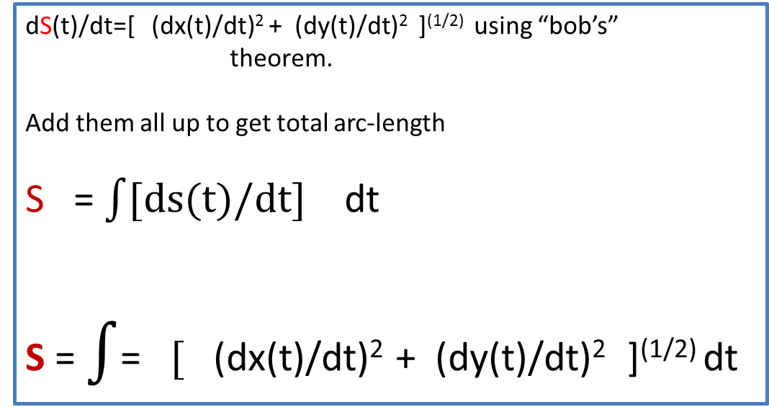
Math 53: Fall 2025, UC Berkeley Lecture 09 Copyright: J.A. Sethian
Review of First Third of the Course
Arc-length of parameterized curves
y
B
(At t=t₁)
(x(t), y(t)) describes curve in 2D.
What is the total arc-length S from A to B?
A
At t=t₀
S
x
dS(t)/dt=[ (dx(t)/dt)² + (dy(t)/dt)² ]^{(1/2)} using “bob’s”
theorem.
Add them all up to get total arc-length
S = $\int{[ds(t)/dt]}$ dt
S = $\int{\text{=}} [$ (dx(t)/dt)² + (dy(t)/dt)² ]^{(1/2)} dt
y
ds(t)/dt
t₁
dy(t)/dt
dx(t)/dt
t₀
x
t₁
t₀
All rights reserved. You may not distribute/reproduce/display/post/upload any course materials in any way, regardless of whether or not a fee is charged, without my express written consent. You also may not allow anyone else to do so. If you do so, you will be prosecuted under UC Berkeley student proceedings Secs. 102.23 and 102.25 sethian@math.berkeley.edu

Slide 4
Math 53: Fall 2025, UC Berkeley Lecture 09 Copyright: J.A. Sethian
Vectors
Ѳ
Two vectors in 3D: angle between is
Dot product
V=(v₁,v₂,v₃)
z
Definition of dot product:
U dot V = (u₁*v₁ + u₂*v₂ + u₃*v₃)
Ѳ
y
Proved: U dot V = |U| |V| cos
U=(u₁,u_{2,}u₃)
Ѳ
Proved:
Two vectors are orthogonal U dot V=0
x
Cross product
Given two vectors in 3 dimensions
z
W=(w₁,w₂,w₃)
Can define their cross product as U x V =
W=(u₂*v₃-u₃*v₂,u₃*v₁-u₁*v₃,u₁*v₂-u₂*v₁)
y
V=(v₁,v₂,v₃)
Proved: W=U x V is orthogonal to U and to V
Ѳ
Ѳ
Proved: |U x V| = |U||V| sin
U=(u₁,u_{2,}u₃)
x
Proved: |U x V| = area of parallelogram
All rights reserved. You may not distribute/reproduce/display/post/upload any course materials in any way, regardless of whether or not a fee is charged, without my express written consent. You also may not allow anyone else to do so. If you do so, you will be prosecuted under UC Berkeley student proceedings Secs. 102.23 and 102.25 sethian@math.berkeley.edu

Slide 5
Math 53: Fall 2025, UC Berkeley Lecture 09 Copyright: J.A. Sethian
Defining planes
using vectors
A plane is completely described if you are given a point P=(x₀,y₀,z₀) and normal vector N
For any point (x,y,z) in the plane, the vector that connects (x,y,z) to P is given by V = (x-x₀,y-y₀,z-z₀)
N = (a,b,c) normal vector
We can write an equation for any point (x,y,z) in the plane by realizing that any such vector V in the plane must be orthogonal to N: that is, N dot V = 0
R
P=(x_{o},y_{o},z_{o})
Q
So any point (x,y,z) in the plane must satisfy
N dot V = 0: which is the same as
(a,b,c) dot (x-x₀,y-y₀,z-z₀) = 0 which becomes
a(x-x₀) + b(y-y₀) + c(z-z₀) = 0
V = (x-x₀,y-y₀,z-z₀)
(x,y,z)
If we are not given a normal vector N , but instead have three points P, Q, and R in the plane, we can find a normal vector N by taking the cross product
N = (Q-P) x (R-P)
All rights reserved. You may not distribute/reproduce/display/post/upload any course materials in any way, regardless of whether or not a fee is charged, without my express written consent. You also may not allow anyone else to do so. If you do so, you will be prosecuted under UC Berkeley student proceedings Secs. 102.23 and 102.25 sethian@math.berkeley.edu

Slide 6
Math 53: Fall 2025, UC Berkeley Lecture 09 Copyright: J.A. Sethian
Functions of more than one variable
Input space
Need an extra dimension to graph it
f(x): 1D input
to 1D output
y
y=f(x₀)
y=f(x)
x
(Red arrow is output space)
Function of one variable
x₀
x
z
z=f(x₀,y₀)
y
f(x,y): 2D input to 1D output
(x,y)
z=f(x,y)
x
y
Function of two variables
x
(x₀,y₀)
z
w
w=f(x₀,y_{0,}z₀)
f(x,y,z): 3D input to 1D output
z
w=f(x,y,z)
(x,y,z)
y
(I don’t know how to draw the graph, but it’s there somewhere!)
x
y
(x₀,y₀,z₀)
Function of three variables
x
All rights reserved. You may not distribute/reproduce/display/post/upload any course materials in any way, regardless of whether or not a fee is charged, without my express written consent. You also may not allow anyone else to do so. If you do so, you will be prosecuted under UC Berkeley student proceedings Secs. 102.23 and 102.25 sethian@math.berkeley.edu

Slide 7

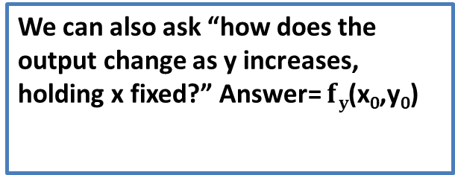
Math 53: Fall 2025 UC Berkeley Lecture 09 Copyright: J.A. Sethian
Derivatives of functions of more than one variable
z=f(x,y)
Start with a function f(x,y)
The graph is 2D surface in R³
z=f(x₀,y₀+h)
z
z=f(x₀+h,y₀)
At an input point (x₀,y₀) the function has an output f(x₀,y₀)
We can ask “how does the output change as x increases, holding y fixed?”
z=f(x₀,y₀)
y
(x₀,y₀+h)
(x₀,y₀)
The slope of the line connecting these changes is $fx$(x₀,y₀)
Slope=f_{x}(x₀,y₀)
x
(x₀+h,y₀)
We can also ask “how does the output change as y increases, holding x fixed?” Answer= $fy$(x₀,y₀)
Slope=f_{y}(x₀,y₀)
All rights reserved. You may not distribute/reproduce/display/post/upload any course materials in any way, regardless of whether or not a fee is charged, without my express written consent. You also may not allow anyone else to do so. If you do so, you will be prosecuted under UC Berkeley student proceedings Secs. 102.23 and 102.25 sethian@math.berkeley.edu

Slide 8
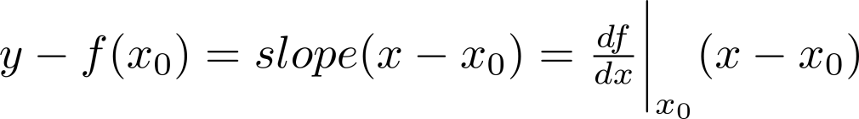
Math 53: Fall 2025, UC Berkeley Lecture 06 Copyright: J.A. Sethian
Section 14.4: Tangent Planes: WHEN YOU ARE GRAPHING OUTPUT AGAINST INPUT!!!!!
Let’s recall 1D Calculus:
y
Tangent line with slope f’(x₀) going through the point (x₀,f(x₀))
y=f(x)
Tangent line at (x₀,f(x₀)) touches the graph y=f(x) at only one point near (x₀,f(x₀))
y=f(x₀)
x=x₀
x
The tangent line is given by
dy
Tangent vector = (dx,dy) = (1, dy/dx)= (1, f’(a))
dx
We want to construct a similar idea for functions of two (or more variables):
The Tangent Plane
1D Output space
Tangent plane
z
y
Tangent plane at (x₀,y₀,f(x₀,y₀)) touches the graph z=f(x,y) at only one point near (x₀,y₀,f(x₀,y₀))
2D Input space
(x₀,y₀)
y
All rights reserved. You may not distribute/reproduce/display/post/upload any course materials in any way, regardless of whether or not a fee is charged, without my express written consent. You also may not allow anyone else to do so. If you do so, you will be prosecuted under UC Berkeley student proceedings Secs. 102.23 and 102.25 sethian@math.berkeley.edu

Slide 9
Math 53: Fall 2025, UC Berkeley Lecture 06 Copyright: J.A. Sethian
Section 14.4: Tangent Planes: WHEN YOU ARE GRAPHING OUTPUT AGAINST INPUT!!!!!
1d: Slope of a tangent line
2d: Formula for the tangent plane
All rights reserved. You may not distribute/reproduce/display/post/upload any course materials in any way, regardless of whether or not a fee is charged, without my express written consent. You also may not allow anyone else to do so. If you do so, you will be prosecuted under UC Berkeley student proceedings Secs. 102.23 and 102.25 sethian@math.berkeley.edu

Slide 10

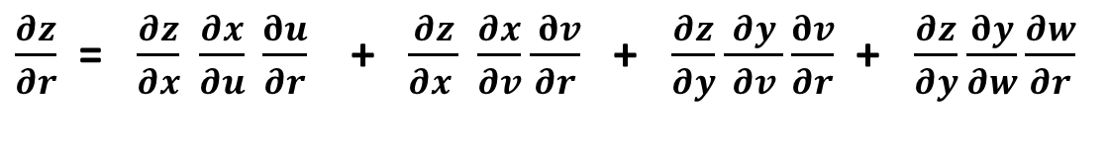
Math 53: Fall 2025, UC Berkeley Lecture 09 Copyright: J.A. Sethian
The Multi-Dimensional Chain Rule
Of one variable:
t
f(t)
x
g(x)
y
$\frac{dy}{dt}$ $=\frac{dy}{dx} \frac{dx}{dt}$
Of many variables:
t
f(r,s,t)
u
a(u,v)
x
s
g(r,s,t)
v
c(x,y)
z
b(v,w)
y
r
h(r,s,t)
w
To find $\frac{∂z}{∂r}$follow all pathways through the graph:
$\frac{∂z}{∂r}$= $\frac{∂z}{∂x} \frac{∂x}{∂u} \frac{∂u}{∂r}$+ $\frac{∂z}{∂x } \frac{∂x}{∂v}\frac{ ∂v}{∂r}$+ $\frac{∂z}{∂y}\frac{ ∂y }{∂v}\frac{∂v}{∂r}$ + $\frac{∂z}{∂y}\frac{∂y}{∂w}\frac{∂w}{∂r}$
All rights reserved. You may not distribute/reproduce/display/post/upload any course materials in any way, regardless of whether or not a fee is charged, without my express written consent. You also may not allow anyone else to do so. If you do so, you will be prosecuted under UC Berkeley student proceedings Secs. 102.23 and 102.25 sethian@math.berkeley.edu

Slide 11
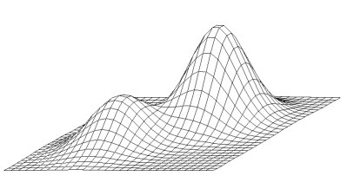


Math 53: Fall 2025, UC Berkeley Lecture 09 Copyright: J.A. Sethian
Critical Values of Multivariable functions
One dimension y=f(x)
y
y
Critical points: Places where df/dx =0
If, in addition, d²f/dx² <0 (>0) then max (min)
x
x
a
b
c
d
e
x=a: global max ||| x=b: global min ||| x=a,c: local maximum |||x=b,d: local min |||x=e: (inflection)
Two dimensions z=f(x,y)
f(a₂,b₂)
Critical points: Places where both =0 and =0
At the input point (a,b) define D as
D(a,b)=f_{xx}(a,b) f_{yy}(a,b) – [f_{xy}(a,b)]²
f(a₀,b₀)
f(a₁,b₁)
Suppose (a,b) is a critical point, then
(a) if D(a,b)>0 and fxx(a,b)>0, then local min
(b) if D(a,b)>0 and fxx(a,b)<0, then local max
(c) if D(a,b)<0, then neither max nor min
(a₀,b₀) = local max. (a₁,b₁) = neither (saddle) (a₂,b₂)= global max
All rights reserved. You may not distribute/reproduce/display/post/upload any course materials in any way, regardless of whether or not a fee is charged, without my express written consent. You also may not allow anyone else to do so. If you do so, you will be prosecuted under UC Berkeley student proceedings Secs. 102.23 and 102.25 sethian@math.berkeley.edu

Slide 12

Math 53: Fall 2025, UC Berkeley Lecture 09 Copyright: J.A. Sethian
Direction Derivatives
We can also ask: Standing at the input point (x₀,y₀), how does the output change if we move in the direction u=(a,b), where u is a unit vector?
z
z=f(x,y)
z=f(x₀,y₀)
y
Slope=D_{u}(x₀,y₀)= direction derivative
u=(a,b)
(x₀+ah,y₀+bh)
(x₀,y₀)
x
And we proved that:
D_{u}(x₀,y₀)=a * f_{x}(x₀,y₀) + b * f_{y}(x₀,y₀)
At x₀,y₀
All rights reserved. You may not distribute/reproduce/display/post/upload any course materials in any way, regardless of whether or not a fee is charged, without my express written consent. You also may not allow anyone else to do so. If you do so, you will be prosecuted under UC Berkeley student proceedings Secs. 102.23 and 102.25 sethian@math.berkeley.edu

Slide 13





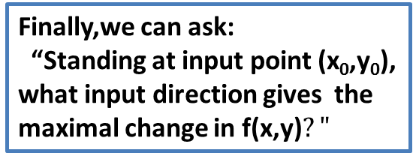
Math 53: Fall 2025, UC Berkeley Lecture 09 Copyright: J.A. Sethian
The gradient
Finally,we can ask:
“Standing at input point (x₀,y₀), what input direction gives the maximal change in f(x,y)$?"$
z
z=f(x,y)
z=f(x₀,y₀)
y
(x₀,y₀)
x
The answer is to move in the gradient direction
Why? Because
is biggest when
And when , then so and point in the same direction
All rights reserved. You may not distribute/reproduce/display/post/upload any course materials in any way, regardless of whether or not a fee is charged, without my express written consent. You also may not allow anyone else to do so. If you do so, you will be prosecuted under UC Berkeley student proceedings Secs. 102.23 and 102.25 sethian@math.berkeley.edu
Ѳ

Slide 14

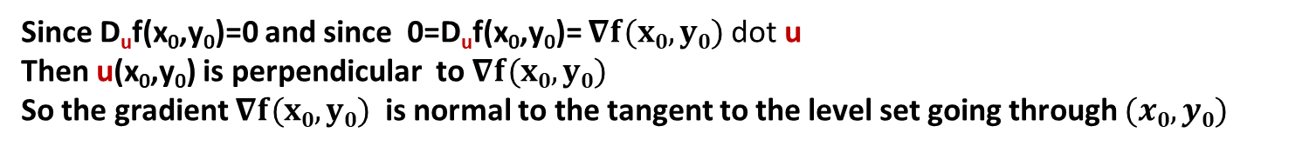
Math 53: Fall 2025, UC Berkeley Lecture 09 Copyright: J.A. Sethian
Level Sets
Start with a function f(x,y)
The graph is 2D surface in R³
z
z=f(x,y)=x²+y²
Level set with value k is the set of all input points sent to the value k.
Height k=f(x₀,y₀)
y
Moving along the k level set in input space, the function f(x,y) doesn’t change
(x₀,y₀)
$$∇f(x0,y0)$$
So, if u is a direction along the k level set, then D_{u}f(x₀,y₀)=0
“k level set”: all input points sent to the same output k
u
Direction of maximal change
D_{u}f(x₀,y₀)=0
x
The gradient at f(x₀,y₀) is the direction of maximal change
Since D_{u}f(x₀,y₀)=0 and since 0=D_{u}f(x₀,y₀)= $∇f(x0,y0)$ dot u
Then u(x₀,y₀) is perpendicular to $∇f(x0,y0)$
So the gradient $∇f(x0,y0)$ is normal to the tangent to the level set going through $(x0,y0)$
All rights reserved. You may not distribute/reproduce/display/post/upload any course materials in any way, regardless of whether or not a fee is charged, without my express written consent. You also may not allow anyone else to do so. If you do so, you will be prosecuted under UC Berkeley student proceedings Secs. 102.23 and 102.25 sethian@math.berkeley.edu

Slide 15
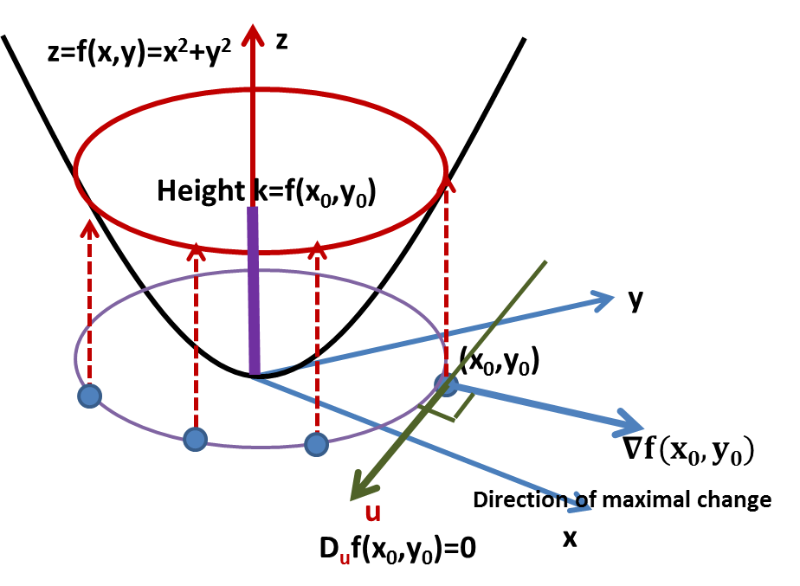


Math 53: Fall 2025, UC Berkeley Lecture 09 Copyright: J.A. Sethian
Level Sets in Higher Dimensions
Again. At input (x₀,y₀) the gradient is normal to the line tangent to the k=f(x₀,y₀) level curve passing through (x₀,y₀).
This same idea is true in higher dimensions. For a function w=f(x,y,z), the input space is three-dimensional.
Input space for f(x,y,z)
z
Tangent plane
Gradient
$$∇f(x0,y0,z0)$$
At input (x₀,y₀,z₀), the gradient is normal to the *plane tangent* to the k=f(x₀,y₀,z₀) level set passing through (x₀,y₀,z₀).
y
w
(x₀,y₀,z₀)
k=w₀=f(x₀,y₀,z₀)
z
(x,y,z)
Input space
So we have an equation for the tangent plane at the point (x₀,y₀,z₀), since we know a point and the normal
y
x
(x₀,y₀,z₀)
Every (x,y,z) input point on this k-level surface is sent to the same output k=f(x₀,y₀,z₀)
x
$$∇f(x0,y0,z0)$$
Graph of output vs. input
All rights reserved. You may not distribute/reproduce/display/post/upload any course materials in any way, regardless of whether or not a fee is charged, without my express written consent. You also may not allow anyone else to do so. If you do so, you will be prosecuted under UC Berkeley student proceedings Secs. 102.23 and 102.25 sethian@math.berkeley.edu

Slide 16




Math 53: Fall 2025, UC Berkeley Lecture 09 Copyright: J.A. Sethian
Finally, there is some (understandable) confusion about tangent planes. Let me try to sort it out
Suppose y=f(x). Find the tangent at input x₀
Example: y=x² x₀ = 3
*Two* ways to do this:
Way #1: Interpret y=f(x) as the graph of output against input:
Output
A mapping from
Input space
Step 1: Draw the output against input
Step 2: Want the tangent point at (3,f(3)) = (3,9)
Step 3: We need the slope to use the formula
Step 4: Slope is = df/dx = 2x: at input x₀=3, slope is 6.
So answer is y-9 = 6(x-3) which we can rewrite as y = 6x - 9
Input
Way #2: Consider a new function w(x,y) = y-f(x): w(x,y)=y-x² is a mapping from
y
(x,y)
Output
w
Step 1: Realize that the zero level set of function w(x,y)
is the red curve, which is the set of all (x,y) sent to
output 0, in other words, whenever g=f(x)
Step 2: So, the input x₀=3, y₀=9 gets sent to w = 0
Step 3: That means that at the input (3,9) the gradient
is normal to the tangent to the level set 0=y-x²
Step 4: So, using the normal equation for a line
y
x
x
Input space
Input
Zero level set
All rights reserved. You may not distribute/reproduce/display/post/upload any course materials in any way, regardless of whether or not a fee is charged, without my express written consent. You also may not allow anyone else to do so. If you do so, you will be prosecuted under UC Berkeley student proceedings Secs. 102.23 and 102.25 sethian@math.berkeley.edu

Slide 17
Math 53: Fall 2025, UC Berkeley Lecture 09 Copyright: J.A. Sethian
Final question: Why would you ever use the second way?
Answer: because you might get asked to find the tangent to the following funky curve at point P –it’s not a function….
P
All rights reserved. You may not distribute/reproduce/display/post/upload any course materials in any way, regardless of whether or not a fee is charged, without my express written consent. You also may not allow anyone else to do so. If you do so, you will be prosecuted under UC Berkeley student proceedings Secs. 102.23 and 102.25 sethian@math.berkeley.edu

Slide 18


Math 53: Fall 2025, UC Berkeley Lecture 09 Copyright: J.A. Sethian
Example: Find the tangent to w=f(x,y,z) = x² + y² + z² at the input (1,2,3)
Way #1: Interpret w=f(x,y,z) as the graph of output against input:
A mapping from
Step 1: Want the tangent object at the point (1,2,3,f(1,2,3)) = (1,2,3,14)
Step 2: We need the various partials to use the formula
Step 4: f_{x}=2x, f_{y}=2y,f_{z}=2z---so (f_{x},f_{y},f_{z}) =(2,4,6).
So tangent object is w=14 + (2)(x-1)+(4)(y-2)+(6)(z-3)= 2x+4y+6z+14
Way #2: Think of the equation w=f(x,y,z) as a particular level set of a new function
U(x,y,z,w) = w-f(x,y,z)=w-(x²+y²+z²) is a mapping from
Step 1: Realize that the zero level set of function U(x,y,z,w)
is the set of all (x,y,z,w) sent to output 0
Step 2: So, the input x₀=1, y₀=2, z₀=3, w₀=14 gets sent to U = 0
Step 3: That means that at the input (1,2,3,14) the gradient
is normal to the tangent to the level set 0= w-(x²+y²+z²)
Step 4: The gradient at input (1,2,3,14) is
All rights reserved. You may not distribute/reproduce/display/post/upload any course materials in any way, regardless of whether or not a fee is charged, without my express written consent. You also may not allow anyone else to do so. If you do so, you will be prosecuted under UC Berkeley student proceedings Secs. 102.23 and 102.25 sethian@math.berkeley.edu

